Slide 1
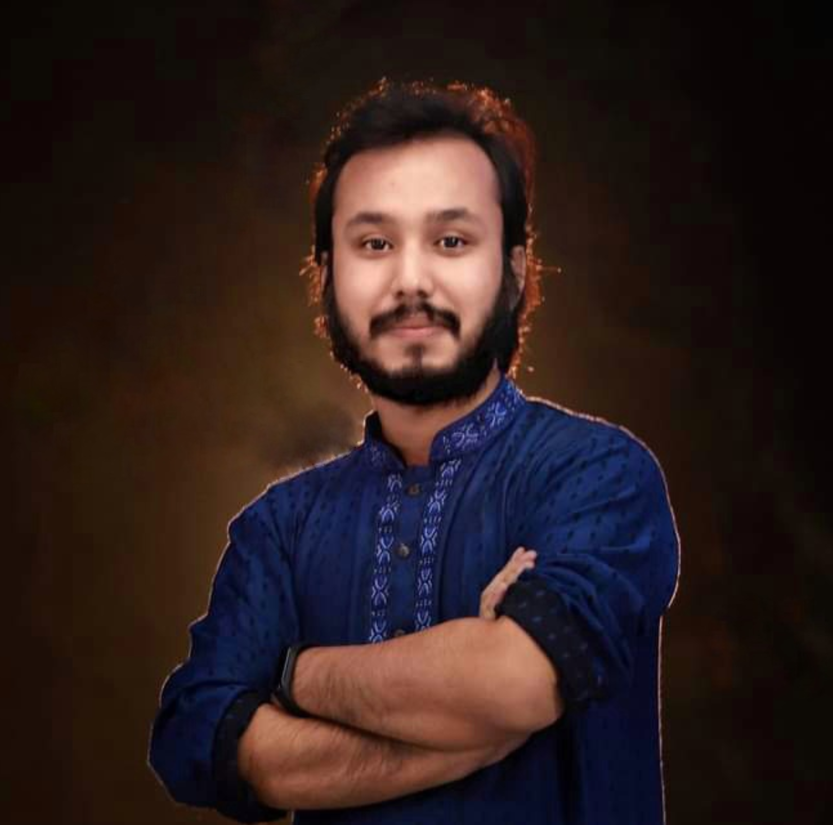
Kowshique Roy
Online Class
printf ( “Hello World” ) ;
Studying MSc in Computer Science (PMSCS) at
Jahangirnagar University
Whatsapp: 01765236683 Mail: kowshiqueroy@gmail.com Youtube: Dadar Class দাদার ক্লাস

Slide 2

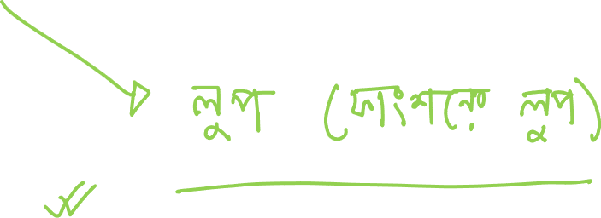
Function Call
Recursion

Slide 3
